Slide 1
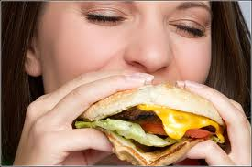
Part I: Our NEED: Can you be Hungry & Healthy @ Same Time?
Healthy and Hungry?

Slide 2
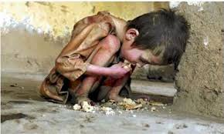
Answer: Maybe
Hunger can be in a healthy state.
Hunger can be in an unhealthy state (starving).

Slide 3
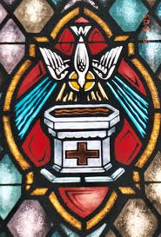
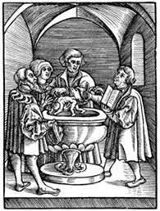
God Made You “Healthy” in Holy Baptism!
In Holy Baptism you were united to Jesus and forgiven ALL of your sins!

Slide 4
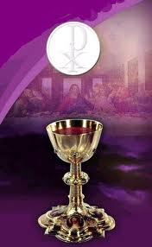
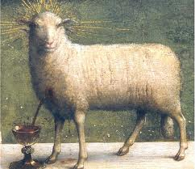
But because you still sin, you still get “hungry” for forgiveness!
Communion gives the SAME forgiveness as baptism, but you get it in a DIFFERENT way to keep you FED with forgiveness because you still struggle with sin!

Slide 5
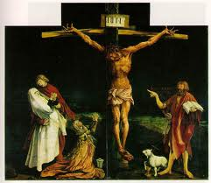
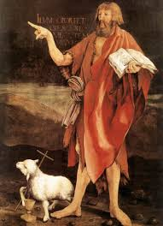
Part 4: Who is Worthy?
There is really only ONE who is WORTHY!
Revelation 5:12: “Worthy is the lamb who was slain!”

Slide 6
But God has decided that whoever believes in the Lamb (Jesus) has His eternal life! [John 3:16]
And when we trust in Jesus, Jesus SHARES with us what made Him worthy. When He was slain (Rev. 5:12), what came out of His body? Answer: His ____________!
1. So exactly what are we supposed to believe in when we say we believe in Jesus?
2. What are we trusting in for forgiveness of our sins and eternal life?

Slide 7
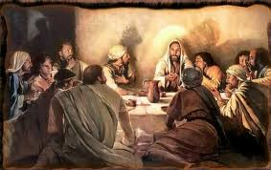
Luther said:
“But that person is truly worthy and well prepared who has faith in these words, ‘Given and shed for you for the forgiveness of sins.’” Luther’s Small Catechism

Slide 8
What does worthy reception look like?
Given and shed for you!
Given and shed FOR YOU!

