Slide 1
God Takes Care of Your Conscience
Higher Things 2013: From Above, Rev. Dr. Al Espinosa, Ph.D., senior pastor, Saint Paul’s Lutheran Church of Irvine (LC-MS)

Slide 2
Breakaway Sectional Description
God Takes Care of Your Conscience The power of the God’s Word, personally applied through our pastor—one-on-one—is God’s way of helping us to deal with the sins that hang around in our hearts and minds. Yes, all sins are covered by the blood of the Lamb, but there are some sins that keep coming back to haunt us. What are we to do with these? Thanks be to God that we may come to our pastors and receive this healing gift called: Individual Confession and Absolution.

Slide 3
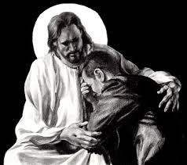
This is a special gift given to all Christians! What is comforting about this picture?

Slide 4
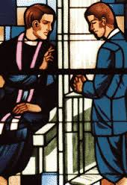
But hold on…that previous picture was a picture of Jesus…how can we come to Jesus today?
Luke 10:16: “The one who hears you hears me…”

Slide 5
It flows from the power of the Keys

Slide 6
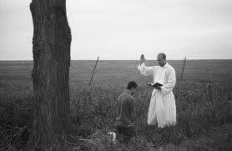
Jesus gave this power to His Church
Matthew 16:19: “I will give you the keys of the kingdom of heaven, and whatever you bind on earth shall be bound in heaven, and whatever you loose on earth shall be loosed in heaven.”

Slide 7
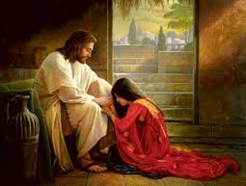
So when your pastor serves you with Jesus’ keys and promise…
Small Catechism: “…we receive absolution, that is, forgiveness, from the pastor as from God Himself…”

Slide 8
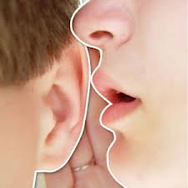
This is so sacred, that pastor’s are bound to a sacred oath

Slide 9
But are we contradicting GRACE alone through FAITH alone in CHRIST alone?
No, because individual confession and absolution is NOT the work of man, but the work of God…
It is the application of the power of the Word of Christ!

Slide 10
Once upon a time, confession and absolution changed…
The Council of Florence in 1439 the Roman Catholic Church taught it as a three-fold aspect:
Contrition
Confession
Satisfaction

Slide 11
The Reformation went back to teaching this gift according to God’s Word

Slide 12
That is individual confession and absolution is one of the MEANS of GRACE
Preaching and Teaching
Holy Baptism
Holy Absolution
Holy Communion
The Mutual Conversation and Consolation of the Saints

Slide 13
We must receive the Word to unite us to the atoning blood of Jesus!
Luther: “Christ on the cross and all his suffering and his death do not avail, even if, as you teach, they are ‘acknowledged and meditated upon’ with the utmost ‘passion, ardor, heartfeltness.’ Something else must always be there. What is it? The Word, the Word, the Word…Even if Christ were given for us and crucified a thousand times, it would all be in vain if the Word of God were absent and were not distributed and given to me with the bidding, this is for you, take what is yours.” (Against the Heavenly Prophets, LW 40, 212-213)

Slide 14
OK, but what exactly is happening during individual confession and absolution
#1 You freely choose to come…since you can receive absolution through general confession and absolution in worship, you don’t HAVE TO…it’s ALL FREE!

Slide 15
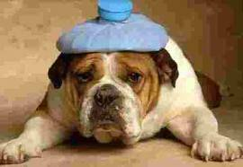
What Exactly Is Happening?
#2 But you FREELY come because even though you know you are forgiven in Christ, something is weighing heavily on your heart and mind…and it just won’t go away! You have a burden and you decide to do something about it…give it to Jesus in this special way!!!

Slide 16
What exactly is happening?
#3 You know what God’s Word says about confession!
Psalm 32:3: “For when I kept silent, my bones wasted away through my groaning all day long.”

Slide 17
What exactly is happening?
#3 You know what God’s Word says about confession:
Psalm 32:5: “I said, ‘I will confess my transgressions to the Lord,’ and you forgave the iniquity of my sin.”

Slide 18
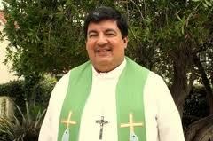
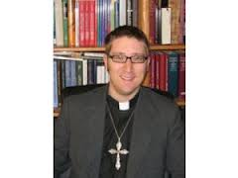
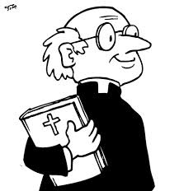
What exactly is happening?
#4 Call your pastor and set up a meeting.

Slide 19
What exactly is happening?
#5 You don’t try to list every sin (because you can’t, Psalm 19:12), just the sins that are heavy on your heart!

Slide 20
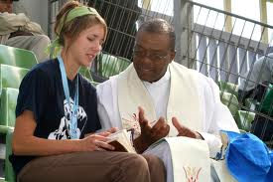
Exactly what is happening?
#6 Confess what you need to confess…

Slide 21
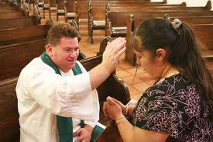
Exactly what is happening?
#7 The pastor will not judge you or condemn you…instead, he will ABSOLVE you! FORGIVE you!

Slide 22
But what if I commit the same sin again?
Remember Jesus told his disciples to forgive “seventy times seven”!!!

Slide 23
The evil one wants to convince you that you’ve gone too far in your sin…
He is a LIAR! John 8:44: he is the father of ____!

Slide 24
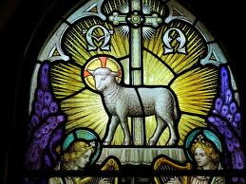
How do we know that he lies?
Because NO sin is too GREAT for The Lamb of God!

Slide 25
We use this gift also to prepare for the Sacrament

Slide 26
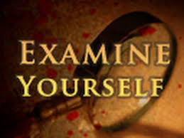
1st Corinthians 11
We must examine ourselves and this is done esp. through confession and absolution!

Slide 27
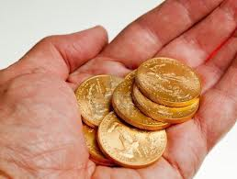
Is there a better way than individual confession and absolution?
Illustration:

Slide 28
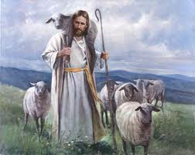
And there is another benefit!
You allow your pastor to be more of a…

Slide 29
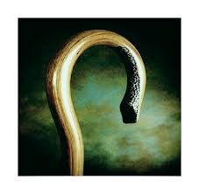
He won’t bring up your sin, but he will…
Closer to you…and help you stay strong to whatever is confronting you or tempting you!

Slide 30
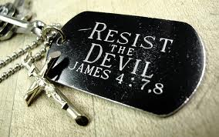
Best of all…you will be protected from the evil one’s accusations!
James 4:7 is now given a basis, a grounding, a reason…how are you able to resist?

