Slide 1
Angels and Demons
Higher Things 2014, Pastor Espinosa, Saint Paul’s Lutheran Church of Irvine, CA, Ph.D. Theology

Slide 2
Preliminary Notes
1. Prayer
2. Introduction
3. Topic must never cloud Christ…but think about how the culture presents the topic…how often is the Gospel heard?
4. Then why study it? Full counsel of God + encouragement + warning (protection).
5. Also we must remember this when we get to the demonic: 2nd Thessalonians 2:11-12:

Slide 3
Second Thessalonians 2:11-12
“Therefore God sends them a strong delusion, so that they may believe what is false, in order that all may be condemned who did not believe the truth but had pleasure in unrighteousness.”
Luther: “I am saying this to keep you from believing in all sorts of miracles and signs…God permits the false Christians to be tempted in this way; they have to believe lies because they refused to believe the truth.” (“Sermons on the Gospel of St. John,” LW 24, pp 73-76)

Slide 4
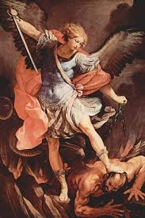
All of this under heading: Angelology (e.g. Rev. 12:7-9…)
Why was there a war in heaven?
There are only three angels named in Scripture…this picture has two of them…names?*
This picture also teaches that there are two kinds of angels. What are they?
Does God need angels?
Is God teaching Manichaeism (cosmic dualism)? Good and evil as equal forces?
Who came to destroy the works of the devil? (1st John 3:8b)
* technically, “angel” means “messenger” … in the broad sense, many more “messengers” are named in Scripture (e.g. John the Baptist and even our Lord Himself…your pastor is an “angel” in this sense)!

Slide 5
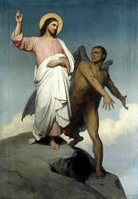
Christ is over all (Matthew 4 and Luke 4)! Again, check fascination!

Slide 6
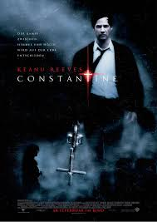
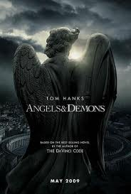
Unfortunately, our culture is crazy about angels…not good!

Slide 7
The attitude of the holy angels…
St. John experienced this:
“I, John, am the one who heard and saw these things. And when I heard and saw them, I fell down to worship at the feet of the angel who showed them to me, but he said to me, ‘You must not do that! I am a fellow servant with you and your brothers the prophets, and with those who keep the words of this book. Worship God.’” – Revelation 22:8-9

Slide 8
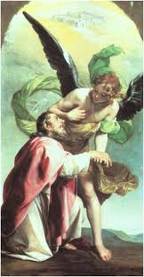
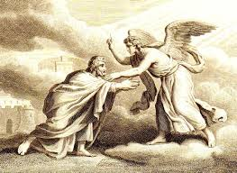
The Angel in Revelation refused to be worshipped!

Slide 9
The worship of angels is considered false teaching!
“Let no one disqualify you, insisting on asceticism and worship of angels, going on in detail about visions, puffed up without reason by his sensuous mind, and not holding fast to the Head…” – Colossians 2:18-19
“…Christ is the head of the church, his body…” – Ephesians 5:23

Slide 10
But Scripture teaches the reality of angels…what do they do?
They always behold God (Matt. 18:10).
They praise God (Is. 6:3; Luke 2:13).
They are God’s servants in the world and in the Church (Ps. 103:20-21; Ps. 104:4; Heb. 1:14).
They help believers in their work and calling (Ps. 91:11-12).
They minister to believers when they die (Luke 16:22).
They rejoice over the repenting sinner (Luke 15:10).
They are present at great events (like the conception, birth, resurrection, & return of Christ).
They are present in the public worship of Christians (1st. Corinthians 11:10). They attend Higher Things!

Slide 11
Hebrews 1:14: Thank God!
“Are they not all ministering spirits sent out to serve for the sake of those who are to inherit salvation?” – Hebrews 1:14

Slide 12
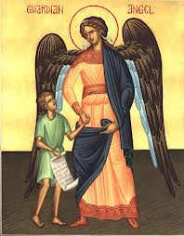
Close to the concept of “guardian angel” (term not in Scripture)

Slide 13
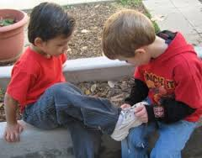
Angels are spirits (immaterial), but may appear as material beings.
Genesis 18 & 19…even consuming food…and consider Hebrews 13:2

Slide 14
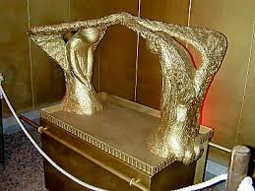
Ranks…Cherubim (Gen. 3:24; Ps. 80:1)
Guardians and Attendants:

Slide 15
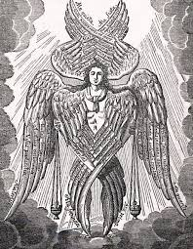
Ranks…Seraphim (Is. 6:2)
Fiery Ones with 6 wings calling, “Holy, Holy, Holy…”!

Slide 16
Ranks…”thrones, dominions, principalities, powers” (Col. 1:16)
Colossians 1:16…there is no precise order or rank, but angels serve different purposes just as humans do…some worship, some are messengers, some are warriors, etc.
Some might say that Colossians is giving an order, but Ephesians 1:21 changes the enumeration: “…rule and authority and power and dominion…”.

Slide 17
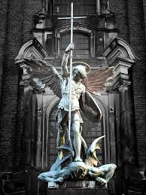
Ranks…archangel (1st Thessalonians 4:16)
Michael is one. One of “chief princes” in Daniel 10 & “great prince” in Daniel 12.

Slide 18
Fallen angels/demons.
Three real-life accounts:
Visitation from a young lady.
Crisis pastoral care in the parish.
Reports of a haunting*
*We realize several possibilities, but this is territory for the demonic.

Slide 19
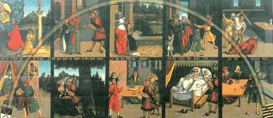
Various ranks also true of demons.
“Beelzebub, the prince of demons”…Luke 11:15. Cranach (Ref. painter, woodcutter)

Slide 20
Fallen angels…the demons
What about the demons…what do they do?
They seek to harm people in their bodies (Luke 13:11, 16).
They seek to harm us regarding our temporal possessions (Job 1:12ff; Matt. 8:31-32).
They seek esp. to harm our soul (1st Peter 5:8).
They seek to cause and maintain UNBELIEF (Eph. 2:1-2).
They fight against the Gospel (Acts 26:18 & Col. 1:13). This is their chief threat.
They spiritually possess and they physically possess.

Slide 21
Luther discusses the two kinds of possession:
People are possessed [by the devil] in two ways: some corporally, according to their [external] humanity, and others spiritually, according to their spirit [or soul], as is the case with all the godless. In those who are corporally possessed and frenzied, the devil inhabits and vexes only the body, not the soul. So the soul remains secure and unharmed. The demons can be driven out of such people by prayer and fasting. (Martin Luther, Table Talk #1170 [1530], Luther’s Works, Vol. 58 [Saint Louis: Concordia Publishing House, 2010], p. 75)

Slide 22
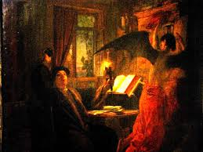
Luther throwing inkwell at the devil! Not authentic, but…

Slide 23
Spiritual Possession is the state of unbelief…this is why we baptize!
Demons keeping people from saving faith!

Slide 24
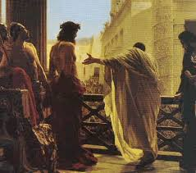
The Evil One “Devours” through the rejection of Christ!

Slide 25
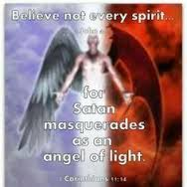
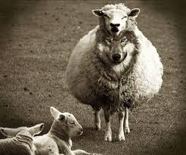
How is the devil so convincing to lead people without the Gospel?
2nd Corinthians 11:14-15: Satan masquerades as “an angel of light” and his servants also masquerade as “servants of righteousness”!

Slide 26
But what about bodily possesion?
Christian theologian (not Lutheran), Merrill F. Unger, in his magnum opus Biblical Demonology says that a Christian “is not liable to demon habitation” since the Christian has the Holy Spirit, etc.
Our Lutheran heritage differs. Bugenhagen, Luther and more recently Pieper present a sobering view. We respond with repentance.

Slide 27
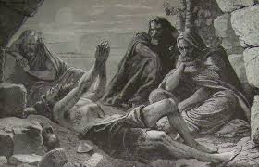
First, know clearly that even a Christian can be greatly afflicted!

Slide 28
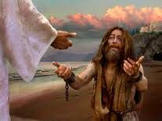
But could a believer suffer bodily possession?
Man possessed by Legion responds in faith after exorcism (Mark 5:18-20)

Slide 29
Crucial note
Diagnoses is a major issue.
We don’t have time to get into this, but see “Quotes and Paraphrases from Lutheran Pastoral Handbooks of the 16th and 17th Centuries on the Topic of Demon Possession.”
-- compiled, edited, and translated by Benjamin Mayes (www.angelfire.com/ny4/djw/lutherantheology.html)

Slide 30
Luther’s testimony in dealing with bodily possession as real possibility
Accordingly you should proceed as follows: Go to him with the deacon [assistant preacher] and two or three good men. Confident that you, as pastor of the place, are clothed with the authority of the ministerial office, lay your hands upon him and say, “Peace be with you, dear brother, from God our Father and from our Lord Jesus Christ.” Thereupon repeat the Creed and the Lord’s Prayer over him in a clear voice, and close with these words: “O God, almighty Father, who hast told us through thy Son, ‘Verily, verily, I say unto you, Whatsoever ye shall ask the Father in my name, he will give it you’ [John 16:23]; who hast commanded and encouraged us to pray in his name, ‘Ask, and ye shall receive’ [John 16:24]; and who in like manner hast said, ‘Call upon me in the day of trouble: I will deliver thee, and thou shalt glorify me’ [Psalm 50:15]; we unworthy sinners, relying on these thy words and commands, pray for thy mercy…”

Slide 31
Continued…
“… Graciously deign to free this man from all evil, and put to nought the work that Satan has done in him, to the honor of thy name and the strengthening of the faith of believers; through the same Jesus Christ, thy Son, our Lord, who liveth and reigneth with thee, world without end. Amen.” Then, when you depart, lay your hands upon the man again and say, “These signs shall follow them that believe; they shall lay hands on the sick, and they shall recover” [Mark 16:17-18]. Do this three times, once on each of three successive days. Meanwhile let prayers be said from the chancel of the church, publicly, until God hears them…Other counsel than this I do not have. (Martin Luther, Letter to Severin Schulze [June 1, 1545], Luther: Letters of Spiritual Counsel, p. 52)

Slide 32
Ingenius insight about our approach to help those in this plight:
Then Dr. Luther spoke, “I know you well, you devil. You would really like it if someone would set up a big ceremony with you and celebrate you greatly. You will find none of that with me.” (Höker, in Ludwig Dunte, Decisiones casuum conscientiae [1664], pp. 100-103; translated by Benjamin Mayes)

Slide 33
Continuation…
He began and spoke: “Now and at our time, people should not drive out devils as it was done at the time of the Apostles and shortly thereafter, when it was necessary to do miracles and signs for the sake of the Gospel, to confirm it as a new doctrine, which now and at our time is not necessary, since the Gospel is not a new doctrine, but has been sufficiently confirmed. And if anyone wants to drive them out as was done at that time, he tempts God,” he said. (Höker, in Ludwig Dunte, Decisiones casuum conscientiae [1664], pp. 100-103; translated by Benjamin Mayes)

Slide 34
Continuation…
“One should also not drive out the devils with conjurations, by commanding, like some in the papacy and even some of our own people do, but one should drive them out with prayers and contempt. [emphasis mine] For the devil is a proud spirit, who cannot stand prayer and despising, but desires a ceremony. Therefore no one should make a ceremony with him, but should despise him as much as possible.” (Höker, in Ludwig Dunte, Decisiones casuum conscientiae [1664], pp. 100-103; translated by Benjamin Mayes)

Slide 35
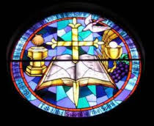
What protects you from spiritual possession?
Your Baptism, the constant hearing of the Gospel, and the Holy Sacrament!

Slide 36
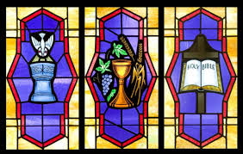
What protects you from bodily possession?
The Same!

Slide 37
Think about what Luther said to remain protected against demons:
1. The Creed!
2. The Lord’s Prayer!
3. Recite the Word of God (e.g. John 16:23 & Psalm 50:15)! “Truly, truly, I say to you, whatever you ask of the Father in my name, he will give it to you.” & “Call upon me in the day of trouble; I will deliver you, and you shall glorify me.”
So what protects you? The WORD of Christ!!!
4. No ceremony, just “prayers and contempt”!

Slide 38
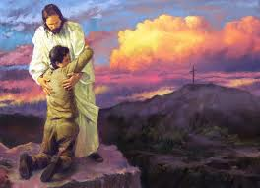
“no one will snatch them out of my hand.” Jn. 10:28

Slide 39
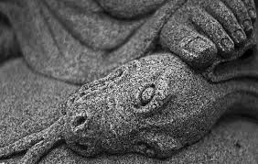
Remember!
“The reason the Son of God appeared was to destroy the works of the devil.” – 1st John 2:8

