Slide 1
The Unity of the Old and New Testaments
Rev. Dr. Alfonso O. Espinosa, Ph.D., Senior Pastor, Saint Paul’s Lutheran Church of Irvine, CA and Adjunct Professor of Theology at CUI

Slide 2
Marcion: Ancient Heretic
He wanted to establish a 2nd century canon and hypothesized that only ten letters of St. Paul and a form of the Gospel of Luke were acceptable.
Why?

Slide 3
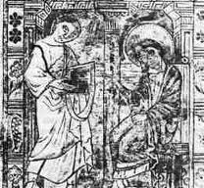
Marcion the Heretic

Slide 4
Because of his dichotomy
1. The true, loving God of Paul and Luke.
VS.
2. The second, inferior god of legalism and wrath.

Slide 5
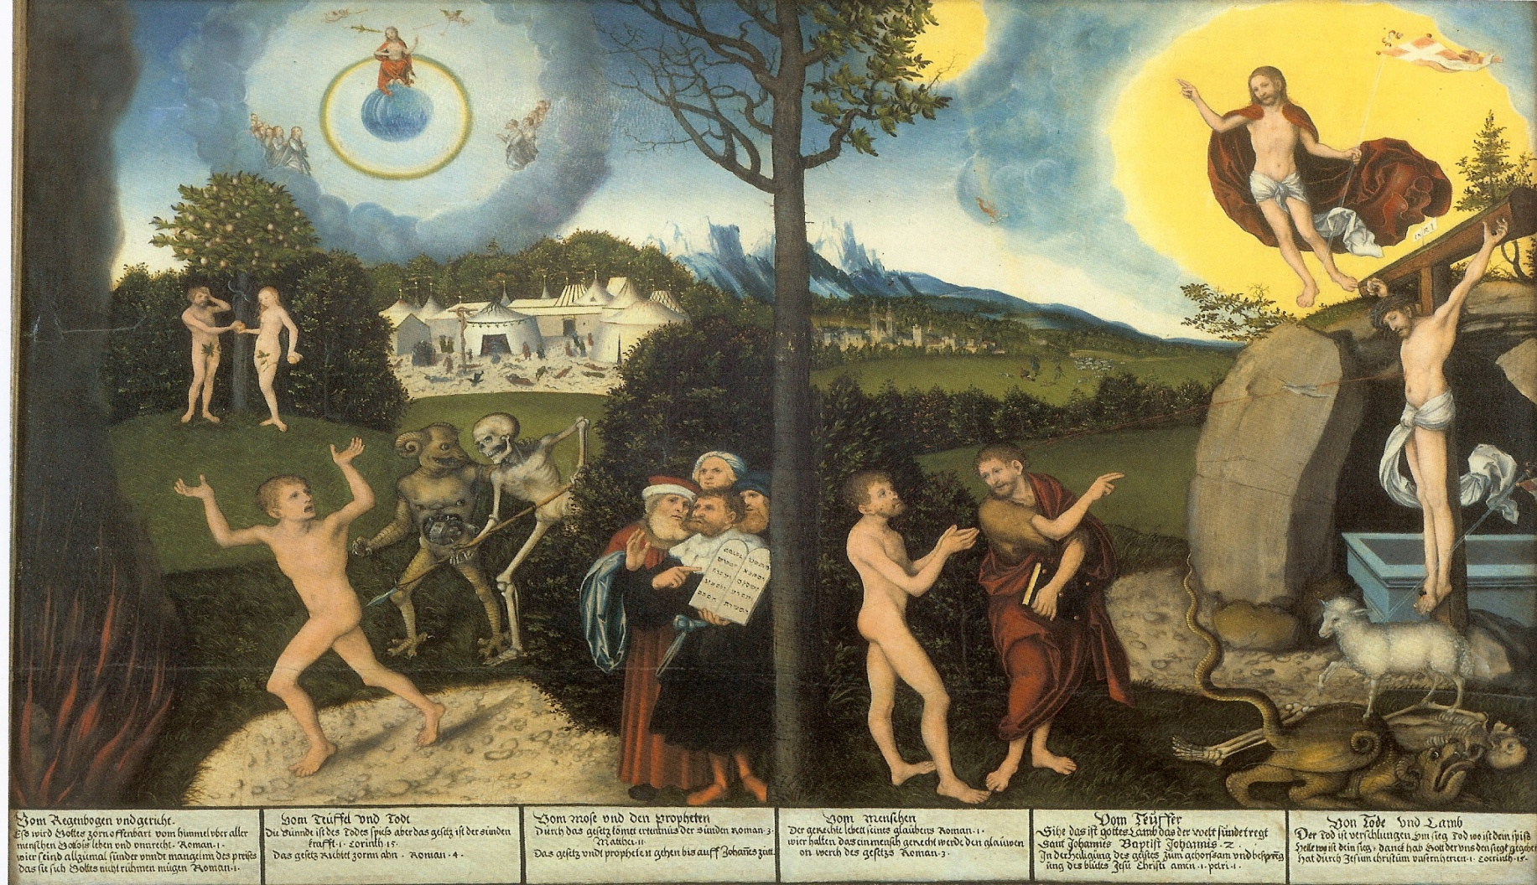
This basic problem persists today!

Slide 6
The false idea that:
The O.T. is all about fire and brimstone; just the LAW.
Vs.
2. The N.T. is all about our loving God, mercy, and grace; just the GOSPEL.

Slide 7
Highly problematic, because…
This could lead a person to neglect the Old Testament. To say it doesn’t apply, doesn’t matter = is irrelevant! Wrong!
Or lead a person to believe that the Christian no longer has use of the Law! Wrong!
Or develop some of Marcion’s crazy idea’s that the O.T. represents a different god altogether! Wrong!
Instead, the two testaments are UNIFIED and ONE!

Slide 8

In logic, this is a non-sequitur and straw-man; very dangerous

Slide 9
Primary verse misused to justify
John 1:17:
“For the law was given through Moses; grace and truth came through Jesus Christ.”
But as TLSB states on page 1777: “A contrast of intensity rather than quality.”

Slide 10
Fact is the O.T. is the theological foundation for the N.T.
1. You can’t understand the concepts in Hebrews, Jude, and Revelation (to name a few) without understanding the O.T.
2. St. Paul constantly appealed to the O.T.
3. St. Matthew quotes the O.T. extensively.
4. Some concepts in the N.T. like “Lamb of God,” “atonement,” “shepherd,” etc. are unintelligible apart from the O.T.

Slide 11
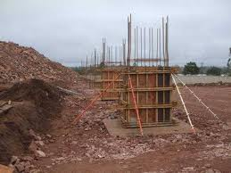
How important are foundations? The O.T. is foundational for N.T.!

Slide 12
The O.T. is also the basis for faith
1. One of the most powerful reasons for having faith is the historical demonstration of fulfilled prophecy.
2. Strobel in The Case of Christ mentions that the odds of one person in human history fulfilling just 8 specific predictions is 1 in 10 E 17.
3. Justin Martyr credits O.T. predictive accuracy for his conversion; Blaise Pascal also cites fulfilled prophecy as key for his faith.

Slide 13
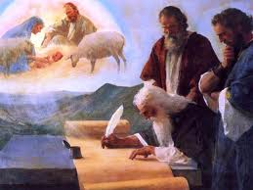
The O.T. predicted Christ!

Slide 14
Not only that, but…
5. This is the Bible that Jesus read!
The O.T. defines his person and mission.
Christ used it to settle controversies (think of how he overcame the devil’s temptations)
He used its images to teach about Himself: for example, “Lamb of God” and “Shepherd.”
The O.T. contains the prayers Jesus prayed from the Psalter (the Psalms) even when He was dying on the cross (Psalm 22).

Slide 15
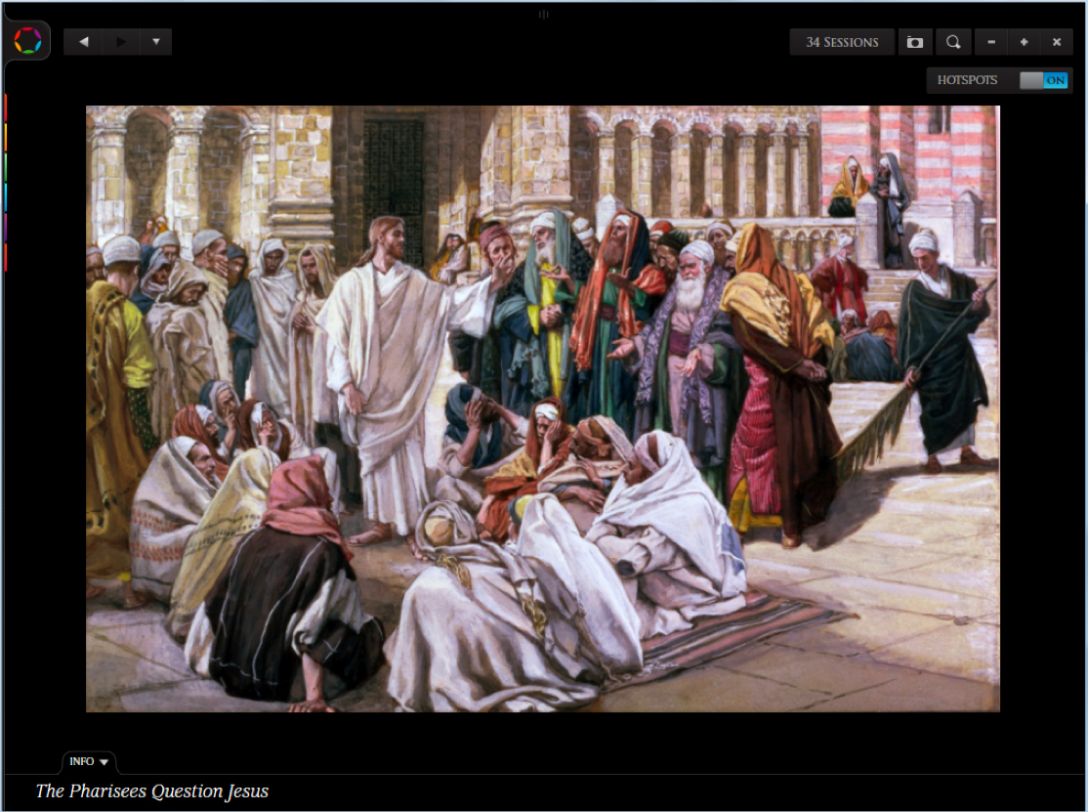
What was Jesus quoting all the time?

Slide 16
The Old Testament is also a lesson of God’s Law and Gospel
1. God is certainly Judge and His sternness and especially His holiness is clearly presented.
2. At the same time, His mercy and compassion is off the charts.
Think of Psalm 23 (recite).
Think of His grace (love and mercy): see Micah 7:18-19.

Slide 17
SOMEONE READ…
Micah 7:18-19!

Slide 18
Jesus’ Witness to the O.T.
Matthew 5:17-18: “Do not think that I have come to abolish the Law or the Prophets; I have not come to abolish them but to fulfill them. For truly, I say to you, until heaven and earth pass away, not an iota, not a dot, will pass from the Law until all is accomplished.”

Slide 19
Jesus’ Witness to the O.T.
Luke 24:44: “Then he said to them, ‘These are my words that I spoke to you while I was still with you, that everything written about me in the Law of Moses and the Prophets and the Psalms must be fulfilled.”

Slide 20
Salvation = the SAME!
Both Testaments share a common plan of salvation:
“Justification by grace through faith in Messiah/Christ apart from the works of the law.”
So what’s the difference between the testaments?
Answer: the perspective of TIME.

Slide 21
Different Time, but Same Salvation
Also Old Testament Habakkuk 2:4:
“…the righteous shall live by his faith.”
New Testament Romans 1:17 quotes Habakkuk 2:4!
Old Testament Genesis 15:6:
“And [Abraham] believed the Lord, and [the Lord] counted it to him as righteousness.”
New Testament Romans 4:3 quotes Genesis 15:6!

Slide 22
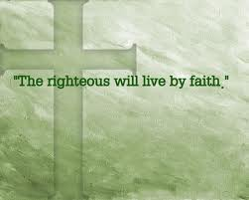
SAME SAVING MESSAGE!

Slide 23
But Faith in Whom?
The Old Testament word for the Savior to have faith in:
Messiah.
The New Testament word for the Savior to have faith in:
Christ.
[both words = Anointed One/King]

Slide 24
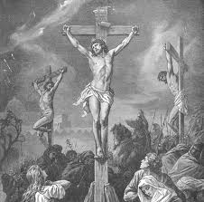
Both Testaments are clear!

Slide 25
Salvation
1. In the Old Testament dispensation, people were saved in the Messiah who was to come in the future.
Time Orientation: Future fulfillment of God’s promises.
2. In the New Testament dispensation, people are saved in the Messiah who has come.
Time Orientation: Past & Present fulfillment of God’s promises.

Slide 26
Jesus Has God’s Great Name!
God appears through the burning bush theophany.
And in what is recorded in Exodus 3, God reveals His Name to Moses.
It is “I Am who/that I Am”: “I Am” = of the root hwh = “to be, become” and is the essential idea of yhwh translated as “Jehovah” or simply “Lord” in English translations.

Slide 27
The Name of God
It may carry the fundamental idea of the self-existence of God, and mean “I am the One who is.”
Or, it may contain the idea of causation and might be translated as “He who causes to be.”
The two views though are complementary: self-existence implies eternality and eternality implies causation in relation to everything else that has a beginning.

Slide 28

Jesus is the Great I AM!

Slide 29
Jesus uses this Name in John 8
Verse 58: “’I tell you the truth,’ Jesus answered, ‘before Abraham was born, I am.’”
The implication is that Jesus was pre-existent to Abraham who was born 2000 years before Christ…that is, Christ is eternal.

Slide 30
So was Jesus with the people of Israel in the O.T.?
This is your big test question!

Slide 31
He was!
“For I want you to know, brothers, that our fathers were all under the cloud, and all passed through the sea, and all were baptized into Moses in the cloud and in the sea, and all ate the same spiritual food, and all drank the same spiritual drink. For they drank from the spiritual Rock that followed them, and the Rock was…” (1st Corinthians 10:1-4)

Slide 32
What is the next word?
Next word, anyone, anyone?

Slide 33
Drumroll….
Anyone, anyone?

Slide 34
The Next Word…
Christ!

Slide 35
See the OT/NT connection via ATONEMENT
The last plague (the 10th plague) in Egypt was God’s judgment of death striking down the first born male.
Here “atonement” is introduced.
The blood of clean lambs was applied to the sides and tops of the doorframes of the houses of the Israelites (Exodus 12:7).

Slide 36
ATONEMENT
God said, “The blood will be a sign for you on the houses where you are; and when I see the blood, I will pass over you.”
This “pass over” was God’s effective solution to the sin of the Israelites.
The blood was key.

Slide 37
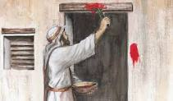
WHY????

Slide 38
ATONEMENT
Atonement = “to be made one with” or “to cover.”
Scriptures teaches that LIFE is in blood (Leviticus 17:11).
So His people are made one with life or are covered with life.
Life covers their sin that brings death, so that their sin is no longer seen, ONLY LIFE.

Slide 39
ATONEMENT
God who is LIFE is now one with those who are marked with or covered by LIFE (blood).
Now God is one with His people

Slide 40
It all pointed to Jesus!
Jesus is “the Lamb of God who takes away the sin of the world (John 1:29 & 36).”
Passover lamb = Jesus is called our Passover Lamb (1st Corinthians 5:7)!
He gives His BLOOD as the atoning sacrifice for our sins (1st John 2:2).

Slide 41
Christ’s Supper and Passover
The Israelites were given a passover meal to commemorate God’s deliverance.
When Christ celebrated this, He took the 3rd cup (the cup of redemption) and made it the basis for the Lord’s Supper.
He called it “my blood of the new covenant”…the blood of the Lamb is our life!

Slide 42
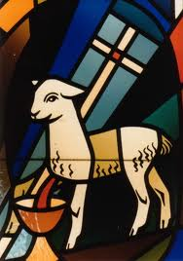
Lamb of God/Agnus Dei

Slide 43
The Exodus also has Baptismal Implications
1st Corinthians 10:12 says that Israel was “baptized” into Moses. Christians are baptized into Christ (Romans 6).
Parallels:
Slavery—deliverance---Red Sea—wilderness------Promised Land
Sin------salvation----Baptism—earthly stay-----Heaven

Slide 44
Also consider: Joshua and Jesus
Means the same = “Savior”
Parallels:
Joshua--beyond Moses--leads Israel to rest
Jesus--beyond Moses--leads “Israel” to rest

Slide 45
The Judges Cycle
Apostasy (sin)
Oppression (punishment)
Distress (repentance)
Deliverance
Peace

Slide 46
That is our cycle!
The Christian life is like Israel’s life!

Slide 47
The Unity between Old & New Testaments
Messiah (O.T.) and Christ (N.T.).
The zerah line. The Old Testament royal line leads to Christ.
Justification by grace through faith.
Basis for salvation: atonement. The same in both testaments. Life is in the blood (Leviticus 17:11).
Law and Gospel in both Testaments.
Divine monergism in both Testaments.
Messianic prophecy (O.T.) and Messianic fulfillment (N.T.).
Also: Old Testament TYPE and New Testament ANTITYPE.

Slide 48
A type is a foreshadowing of something to come called “antitype”
That which foreshadows something to come in the future is called the “type.”
That which is foreshadowed and is in the future which the type corresponds to is called the “antitype.”
In summary, Old Testament types foreshadow New Testament antitypes.

Slide 49
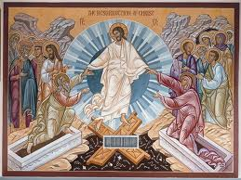
The First Adam (type) Being Raised By Christ the Second Adam (antitype)

Slide 50
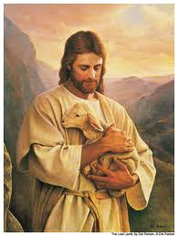
Christ our Sabbath Rest

Slide 51
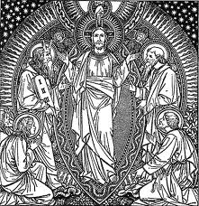
The Transfiguration: Prophetic types to the Prophetic antitype

Slide 52
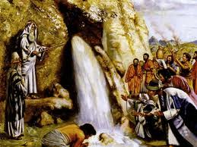
Water from the Rock (Exodus 17)

Slide 53
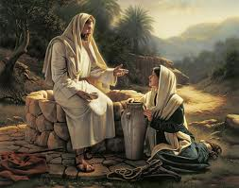
Christ gives Living Water (John 4)

Slide 54
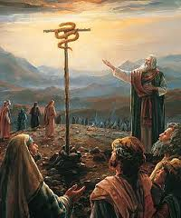
The Bronze Serpent & Christ

Slide 55
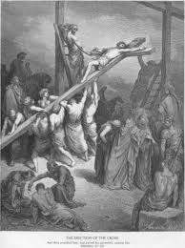
Christ was lifted up

Slide 56
Highlights
Isaiah 53:
Messiah is a real person.
He is an Innocent Sufferer (vss. 4, 5, 8, 9 & 12).
He is a Voluntary Sufferer.
He is obedient, humble, and silent (v 7).
He suffers for the love He has for sinners (vss 4 & 12).
He does God’s will completely (v 10).
His suffering is vicarious (vss 4, 5, 6, 8, 10, 11 & 12).
His suffering is redemptive (vss. 5 & 11).
His suffering leads to death (vss. 8 & 10a).
Through His death, there is a way to resurrection (vss. 10b & 11).

Slide 57
Zechariah, one of the post-exilic prophets
His theme, “The Lord is coming to Zion with salvation (9:9)”
3:8-9 depicts the Messiah as both the saving “Branch” (v 8) and “stone” (v 9) and in verse 9 the Lord states that He will remove Israel’s sin in a single day = a foreshadowing of Christ’s atonement on the cross.
12:10 he predicts that Messiah will be “pierced”…the prophets end the Old Testament in anticipation of Christ.

Slide 58
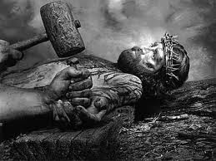
They will look on the One they have pierced

