Slide 1
What the Christian Faith and Tae Kwon Do have in common
Higher Things 2013: From Above, Rev. Dr. Al Espinosa, Ph.D., senior pastor, Saint Paul’s Lutheran Church of Irvine (LC-MS)

Slide 2
Breakaway Sectional Description
What the Christian faith and Tae Kwon Do have in common: In Tae Kwon Do (Korean martial arts) we learn both defensive and offensive techniques. The Christian faith also has defensive protections and offensive weapons against the evil one called "the full armor of God" (Eph. 6). What in the world are these and how are they used? Finally, Tae Kwon Do teaches "forms," and then equips for "sparring." The Christian faith has its "forms" as well in both corporate worship and spiritual discipline, but then we go out into the world to "spar" both in our service and witness!

Slide 3
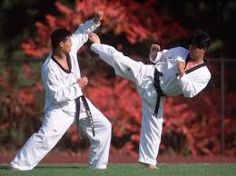
Tae = “To Strike or Break with Foot”

Slide 4
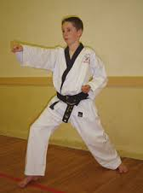
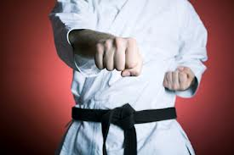
Kwon = “To Strike or Break w/ Fist”

Slide 5
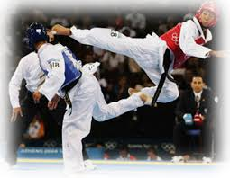
Do = Discipline or Art

Slide 6
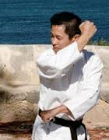
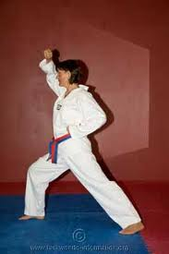
But this art is more than offensive techniques…

Slide 7
Tae Kwon Do provides a powerful analogy to the Christian Faith
The Christian faith also has offensive and defensive aspects in living the faith.
I’m using Tae Kwon Do to make a vivid impression on you about this fact, because the offensive and defensive aspects are often neglected in the Christian faith.

Slide 8
Why are these things neglected?
Because of the problem of reducing the faith to our justification in Christ (the basis for our forgiveness) and leaving out our sanctification in Christ (the basis for our new lives which flow from our justification).
I’m sure you guys are familiar with Ephesians 2:8-10. Recite it!

Slide 9
Ephesians 2:8-10
Teaches that we are both PASSIVE and ACTIVE in our faith!
You are PASSIVE in that you are saved by grace through faith in Christ (which is a GIFT). This is NOT of your own doing!
You are ACTIVE as you live in the good works which God has prepared in advance for you to DO!

Slide 10
Just be clear…
2. BOTH our justification and sanctification; both our passivity and activity are supplied through our Living Lord and Savior Jesus Christ!
Philippians 2:12-13:
¹² Therefore, my beloved, as you have always obeyed, so now, not only as in my presence but much more in my absence, work out your own salvation with fear and trembling, ¹³ for it is God who works in you, both to will and to work for his good pleasure.

Slide 11
Be super clear…
This is not about synergism (cooperating with God) as in God has done His part and now you must do yours. No! The Lord is responsible for BOTH your forgiveness AND your new life…God’s grace is the reason for both your forgiveness AND sanctification!
We confess “grace alone” also known as “divine monergism” = by God’s power ALONE!

Slide 12
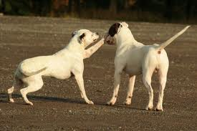
Who’s Being Active? Who’s Being Passive?

Slide 13
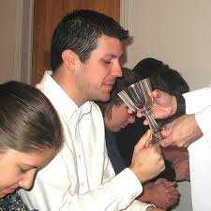
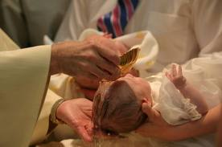
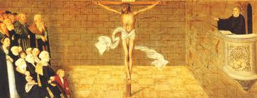
You are PASSIVE as a Christian!

Slide 14
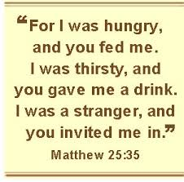
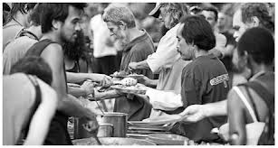
AND you are ACTIVE Christian!

Slide 15
What you experience in God’s grace includes being ACTIVE in…
Worship
Prayer
Service
Witness

Slide 16
But the Enemy Tries to Stop You:
In regards to your salvation by trying to take your eyes off of Jesus so that you might doubt the forgiveness of sins.
But ALSO in regards to your new life to render you ineffective and to stop you from living out your faith!

Slide 17
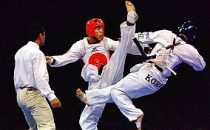
Welcome to the fight!
Saint Paul once described the faith this way: “fight the good fight of faith” 1st Tim 6:12

Slide 18
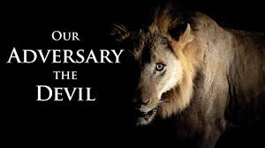
Do you really have an adversary? Yes! 1 Peter 5:8

Slide 19
Didn’t Jesus defeat him?
Yes as in the fulfillment of Genesis 3:15…executing the decisive blow to win the war and our salvation!
Now the evil one is defeated and Revelation 20 describes his defeat as “being bound.”
Think of a junk-yard dog chained to a post.

Slide 20
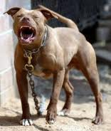
The enemies goal is to get you into his perimeter while he is bound.

Slide 21
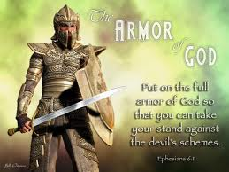
So Saint Paul teaches us about our defensive and offensive weapons

Slide 22
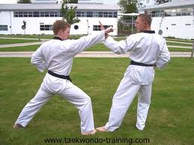
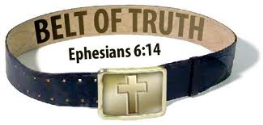
First DEFENSE

Slide 23
The Belt of truth represents…
What comes from your core being; in faith you speak the truth instead of lies…
Why is this so important?
Answer: truth protects your conscience…if you lie, the evil one accuses you of being like the father of lies…truth protects you from his attacking accusations!

Slide 24
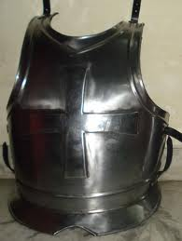
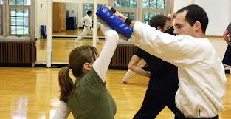
Defense continues…the Breastplate of Righteousness!

Slide 25
The Breastplate protects your…
Heart…your volitional seat…where you express your allegiance (who you serve).
Righteousness in Scripture primarily means Christ’s righteousness for us…
But here in Ephesians 6, it is the active life that flows from Christ leading to righteous deeds or acts = again to protect your conscience from the devil’s accusations!

Slide 26
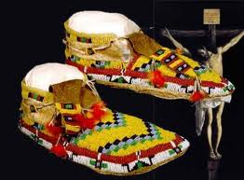
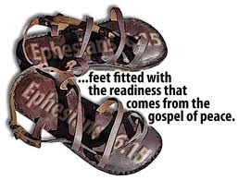
Last defensive weapon…

Slide 27
Wherever you go, you go with the gospel of Christ…
So you walk in the light of the gospel…
that chases darkness away!
This protects you from all darkness…
So your defense: speak truth; do righteous deeds; and go through life with the gospel always with you and in you!

Slide 28
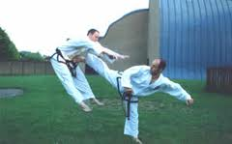
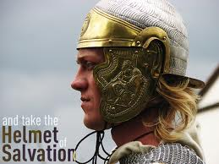
But don’t forget the offensive part! The Helmet of Salvation!

Slide 29
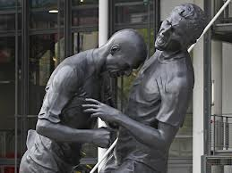
Your mind is protected and is powerful against the enemy…
“Resist him and he will flee from you.” – James 4:7 … memorize Scripture!

Slide 30
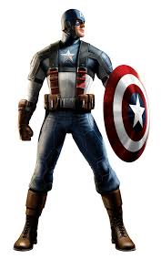
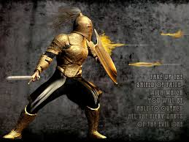
2nd offensive weapon = The Shield of Faith

Slide 31
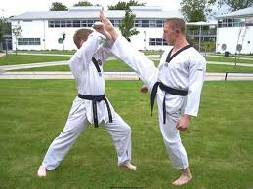
Seems defensive, but consider…

Slide 32
OK, so what exactly is our shield?
Christ Himself.
We lift up Christ…think of the hymn, “Lift High The ______”!
Why? Because on the ______ Jesus took all our sin (2 Cor. 5:21) and all our curse (Gal. 3:13)…He took all of Satan’s flaming arrows for us!

Slide 33
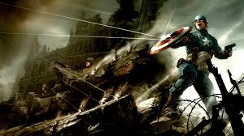
If you’re covered with Christ…
The arrows of the evil one are powerless…
And they just fly back against him!

Slide 34
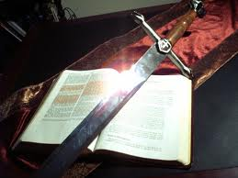
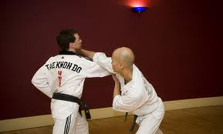
Last offensive weapon: The Sword of the Spirit!

Slide 35
What is it?
The Word of God!
Think of how Christ defeated Satan’s temptations in the wilderness…
By the Word, the Word, the Word!
Matthew 4:1-11

Slide 36
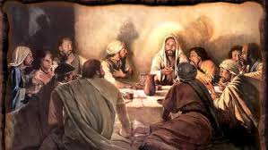
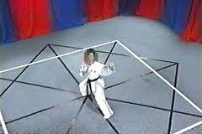
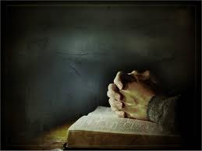
All of the techniques are put together through FORMS

Slide 37
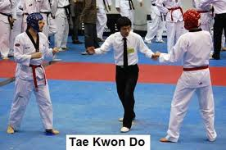
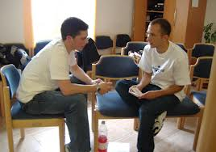
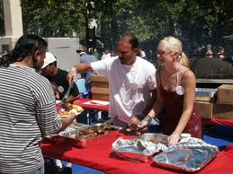
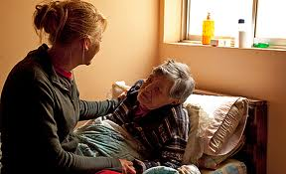
When the techniques & forms are down…you’re ready to SPAR

