Slide 1
Why The Bible is reliable
Pastor Al Espinosa, Saint Paul’s Lutheran Church of Irvine, Ph.D.

Slide 2
Preliminary Notes #1
Prayer
Introduction
Apologetics: based on 1st Peter 3:15: “but in your hearts regard Christ the Lord as holy, always being prepared to make a defense to anyone who asks you for a reason for the hope that is in you;” [“yet do it with gentleness and respect,” vs 16]
“make a defense” = apologia = rational defense
But didn’t Luther call “reason” = “the devil’s whore”? Yes, but reason is to be viewed in one of two ways: 1) Magisterial OR 2) Ministerial.

Slide 3
God gave you a brain…use it (in the MINISTERIAL sense)!

Slide 4
Preliminary Notes #2
6. In apologetics we are using reason in the ministerial sense and in accord with Scripture (i.e. 1st Peter 3:15). Or to put it simply: we put our reason beneath Scripture and use it to glorify the Lord!
7. Even here, however, we must be clear that a rationale defense -- in and of itself -- will never bring a person to saving faith. Only the Holy Spirit working through the Gospel can do that!

Slide 5
The Holy Spirit comes through Word and Sacrament
“The Gospel Shows the Father’s Grace”
Stanza 4: “It is the pow’r of God to save From sin and Sa-tan and the grave; It works the faith which firm-ly clings To all the trea-sures which it brings.”

Slide 6
Explanation of the 3rd Article of the Creed
“I believe that I cannot by my own reason or strength believe in Jesus Christ, my Lord, or come to Him; but the Holy Spirit has called me by the Gospel, enlightened me with His gifts, sanctified and kept me in the true faith. In the same way He calls, gathers, enlightens, and sanctifies the whole Christian Church on earth, and keeps it with Jesus Christ in the one true faith. In this Christian Church He daily and richly forgives all my sins and the sins of all believers. On the Last Day He will raise me and all the dead, and give eternal life to me and all believers in Christ. This is most certainly true.”

Slide 7
Preliminary Notes #3
8. Then why apologetics?
We are commanded to engage in it (i.e. 1st Peter 3:15)!
I argue in the book Theologia et Apologia that apologetics provide the contextual handles for Law and Gospel. For example, eye-witnesses record their encounter with the Risen Christ and non-Christian sources refer to the 1st century testimony that Christ arose. The Gospel includes “Christ is risen!” and this Gospel is couched in real history to which apologetics refers. Thus apologetics is a kind of hand-maiden to the Gospel demonstrating that the Gospel occurred in ordinary history. That is apologetics shows that the Gospel is REAL.

Slide 8
Preliminary Notes #4
9. So apologetics serves our sharing the saving Gospel! Let me share the story about Rick Justice, my friend and brother in Christ.
-- He was an agnostic, leaning towards atheism.
-- He was closed off towards the Word of God…we have to be prepared for this…but he had a seizure one day and was diagnosed with a grade 4 brain tumor…given 3 months. I walked into his hospital room & he laughed!
-- The Lord gave him 6 months and I used apologetics to answer his questions, but always shared the Gospel.
-- Then one day as I was praying next to him [he permitted me to pray for him, but would never pray with me], something happened…

Slide 9
The Foundation for Demonstrating that the Bible is Trustworthy
1. This is a “cumulative case” argument.
2. It does not lead to 100% certainty.
3. We are not trying to “prove” anything.
4. But we ARE demonstrating good reasons as to why God’s Word ought to be considered trustworthy.
From Montgomery’s History, Law and Christianity, there are three main foundations:
#1 Bibliographical evidence
#2 Internal evidence
#3 External evidence

Slide 10
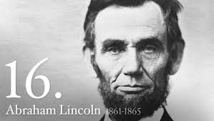
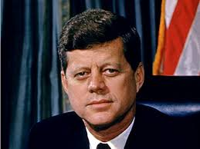
Standards of Ordinary History

Slide 11
You don’t have to believe in Jesus to realize the standards of history
1. Real people.
2. In real places.
3. Engaging in real events.
4. Recorded in real documentation/records.

Slide 12
Example of Real History
First manned moon landing July 20th, 1969.
-- were you there?
-- is it possible that it could have been fabricated?
-- why do you believe actually happened?

Slide 13
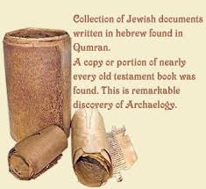
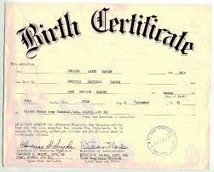
Bibliographical Evidence is the RECORD of ordinary history
What kind of bibliographical evidence exists about YOU?
History is recorded.

Slide 14
Continued…
Until recently (mid-20th cent.), the earliest copies of the Hebrew manuscripts were 9th-century A.D. copies of major portions of the O.T.
These Hebrew texts are known as the Masoretic Text (which means “traditional” text).
These are from scribes called “Masoretes” from Masorah = “tradition”.

Slide 15
Masoretic Text

Slide 16
Bibliographical Evidence continued…
But in 1947 there was a remarkable discovery made in some caves in Qumran (in the West Bank, Palestine). Ancient copies of Old Testament books were discovered as part of the “Dead Sea Scrolls.”
The remarkable thing here is that these Old Testament books are approximately 1000 years older than the Masoretic text!
What is key here though is that the translations are consistent with each other. Why is this significant?

Slide 17
But there’s MORE!

Slide 18
Septuagint
In addition to the Dead Sea Scrolls and the Masoretic Text, there is the ancient Greek translation of the Old Testament called the “Septuagint” (LXX = “70”…this number is based on the tradition that 70 scholars translated the work). These go back to the 3rd century B.C.
Once again, these Old Testament copies are consistent with the other major sources of the Old Testament.
Textual consistency shows that our Old Testament is indeed ancient and well-preserved. These characteristics also put the records in the proximity of the people and events themselves. These are the hallmarks of actual history.

Slide 19
What About the New Testament?

Slide 20
The Bibliographic Evidence for the New Testament is GREAT!
“…but the amount of such evidence available in our own day is so much greater and more conclusive that a first-century date for most of the New Testament writings cannot reasonably be denied, no matter what our philosophical presuppositions may be.” – F.F. Bruce, The New Testament Documents: Are They Reliable? P 15
-- So what? Why does a 1st century origin help Scriptural reliability? Hint: first answer this question: “When did Jesus live, die & rise?”

Slide 21
#2: Internal Evidence!
Internal Evidence: This refers to characteristics within the Bible itself that give signs that it is legitimate history and not myth (this list is from Dr. Ron Rhodes):

Slide 22
Internal Evidence
#1 Genealogies: e.g. Gen 5, 10, 11, 1st Chr 1-9, Mt 1 and Lk 1.
#2 Inclusion of geographical notes: Gen. 13:10 and Dt 1:1-2.
#3 Presence of chronological notes: Lk 3:1-2, Gal 1:18, Gal 2:1.
#4 Bibliographical notes: 2nd Ki 24:5, Lk 1:1-3
#5 Explicit factual claims: Jn 21:24, Acts 26:26-26, Acts 2 “as you all saw”

Slide 23
For Example Real People in Real Places in Real History

Slide 24
Internal Evidence
#6 Explicit denials of myth: 2 Tim 4:3-4, 2nd Peter 1:16, 1st John 1:1-3 (empirical evidence)
#7 Claims to eye-witness testimony: Lk 1:2, 1st Cor 15:6, 1st Jn 1:1
#8 Statements that the readers know to be true: Gal 1:13
#9 Unflattering stories: Peter’s denial, women at the tomb, King David’s failures, Christ “brothers” do not believe, even the cross
#10 Statements that base faith on historical events: 1st Cor. 15 and Psalm 105.

Slide 25
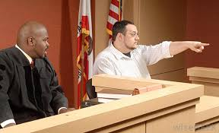
Why Is Eye-Witness Testimony Such A Big Deal?

Slide 26
What About Unflattering Stories?
Blooper 1: The wrong way run!
In 1964, the fantastic Minnesota Vikings defensive end Jim Marshall made a ridiculous error. He grabbed the ball after being turned around by a block and disorientated, and head at top speed for the end zone – only towards his end zone and not the opponents! He ran the full 70 yards to the line, before throwing the ball out of play. His team mates, coaches, 10s of thousands in the stadium and millions watching on TV could only drop their jaws in disbelief. Fortunately, the error had no outcome on the final result, but unfortunately for Marshall he will always be remembered for it!

Slide 27
Jim Marshall

Slide 28
Kinda Like St. Peter!

Slide 29
Why does embarrassing stuff make the Bible more trustworthy?

Slide 30
The BIG Internal Evidence: The 2 E’s! + 1
Eye-Witness Accounts (esp. when they end up giving their LIVES for those accounts)!
Early (record is EARLY in time, super close to the ACTUAL events…not way later like myth and legend)!
Historical Narrative: Is THE genre of space-time history. It’s the way REAL history is recorded!

Slide 31
#3 External Evidence!
Archeology and Secular History Confirm the Old Testament.
The Cylinder of Sennarcherib: 2nd Kings 18:13f. and other references cite Sennarcherib king of Assyria who attacked Judah. The Cylinder is from the Assyrians themselves. The Cylinder also records Sennarcherib’s campaign against Judah!
* About 15 inches long

Slide 32
The Cylinder of Sennacherib: 689 B.C.

Slide 33
2nd Archeological Example: 825 B.C.
Black
Obelisk
Of
Shalmaneser
III containing
Reference
To “Jehu
Son of
Omri”: A
King of Israel
In O.T. 2nd
Kings 9-10
About 6 ft.

Slide 34
Again Real People in Real Places in Real History!
In Genesis alone, there are 60 geographics, 88 personal names, 48 generic names, 21 identifiable cultural items.
Chapter ten of Genesis has 5 times more geographical data than the entire Koran.

Slide 35
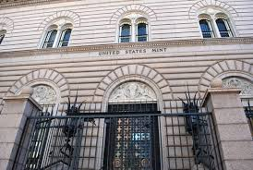
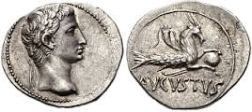
Reliability of Scripture
My personal story about the Denver Mint and coins: Matthew 22:15f.

Slide 36
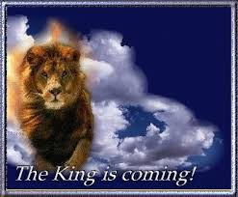
But There’s More!
The most exciting external testimony, however, is MESSIANIC PROPHECY!
Prophecy: The Old Testament contains over 300 future predictions about the coming Christ!

Slide 37
Do the Math!
“Someone did the math and figured out that the probability of just eight prophecies being fulfilled is one chance in one hundred million billion. That number is millions of times greater than the total number of people who’ve ever walked the planet!...if you took this number of silver dollars, they would cover the state of Texas to a depth of two feet.

Slide 38
Do the Math!
If you marked one silver dollar among them and then had a blindfolded person wander the whole state and bend down to pick up one coin, what would be the odds he’d choose the one that had been marked?...the same odds that anybody in history could have fulfilled just eight of the prophecies.” (Strobel, The Case For Christ, p 183)

Slide 39
What are the odds?

Slide 40
One More External Evidence!
From Gary R. Habermas: The Historical Jesus: Ancient Evidence For The Life of Christ.
This work includes listing ancient non-Christian sources that tell something of the life, death and resurrection (acknowledging the 1st century proclamation of it) of Jesus Christ.

Slide 41
Roman historian Tacitus (ca. AD 55-120)
“It is scarcely fanciful to suggest that when he adds that “A most mischievous superstition, thus checked for the moment, again broke out” he is bearing indirect and unconscious testimony to the conviction of the early church that the Christ, who had been crucified had risen from the grave.”
-- J.N.D. Anderson analyzing the words of Tacitus in Habermas, pp 189-190

Slide 42
How Does Our Faith Compare to Other Major Religions?
1. Correspondence theory of truth. Christianity does not separate religion from space and time. Consider Buddhism.
2. Falsifiability makes Christianity unique: Paul didn’t hesitate to use it! Mormonism prefers the “burning in the bosom.”
3. As opposed to Christianity, you just have to take the word of Joseph Smith and Mohammed (visions that happened in a corner).
4. Therefore, we are not intimidated by the question of religious diversity.
6. Logic separates religious doctrine (e.g. resurrection vs. reincarnation) and then we must ask, “Which one has the best evidence?” One may be true, both may be false, but what is NOT a possibility?
7. Paul Maier says, “Archeology is the Bible’s best friend.” [Remember the story of the Denver mint…and now consider for example Mormonism].

Slide 43
And it is this reliable Scripture which testifies to Christ risen!

